Slide 1
Large-scale Packet Classification on FPGA
Authors : Shijie Zhou, Yun R. Qu, Viktor K. Prasanna
Publisher :Application-specific Systems, Architectures and Processors (ASAP), 2015 IEEE 26th International Conference on
Presenter : Kai-Hsun Li
Date : 2015/9/23
Department of Computer Science and Information Engineering
National Cheng Kung University, Taiwan R.O.C.
Notes:
1

Slide 2
Introduction
Packet classification faces two challenges:
(1) the data rate of the network traffic keeps increasing.
(2) the size of the rule sets are becoming very large.
In this paper, we propose an FPGA-based packet classification engine for large rule sets.
Experimental results show that our design can achieve a throughput of 147 Million Packets Per Second (MPPS),while supporting up to 256K rules on a state-of-the-art FPGA.

Slide 3
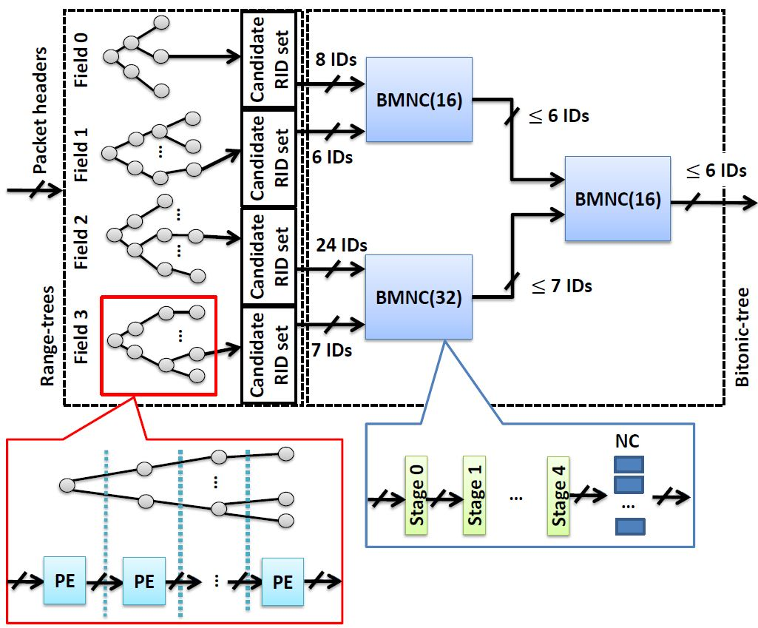
Proposed Scheme
Notes:
這是整體的架構，後面會詳細解釋

Slide 4
Proposed Scheme(1/7)
- Range Tree and Rule ID Set
We exploit range-tree to search each packet header field. For a field requiring range match, the major steps are :
  To flatten all the ranges into non-overlapping subranges.
  To construct a balanced binary search tree using the subrange boundaries.
In our approach, each leaf node of range-tree stores a Rule ID Set (RIDS) and has following properties
  The rule IDs are all distinct.
  The rule IDs are in ascending order.
Notes:
這邊有另外定義存在leaf的rule id set，這2個特性是要方便後面可以做merge用的
rule IDs are all distinct 是在一個RIDS內不會有重複的rule id 出現

Slide 5
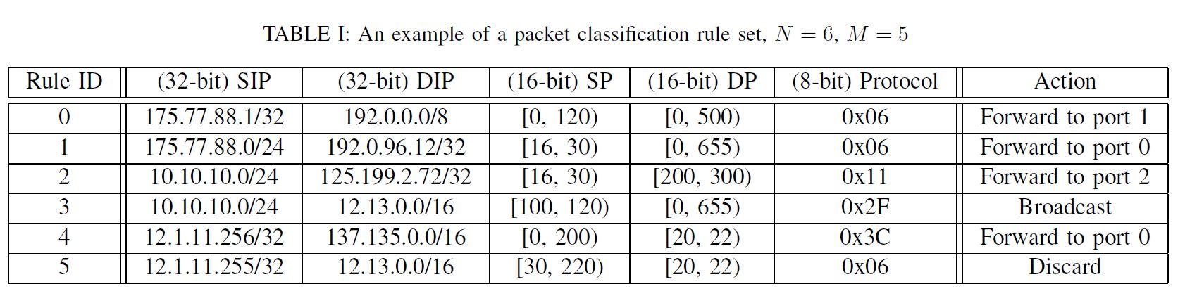
Proposed Scheme(2/7)
- Range Tree and Rule ID Set
Notes:
這是paper提供的rule table

Slide 6
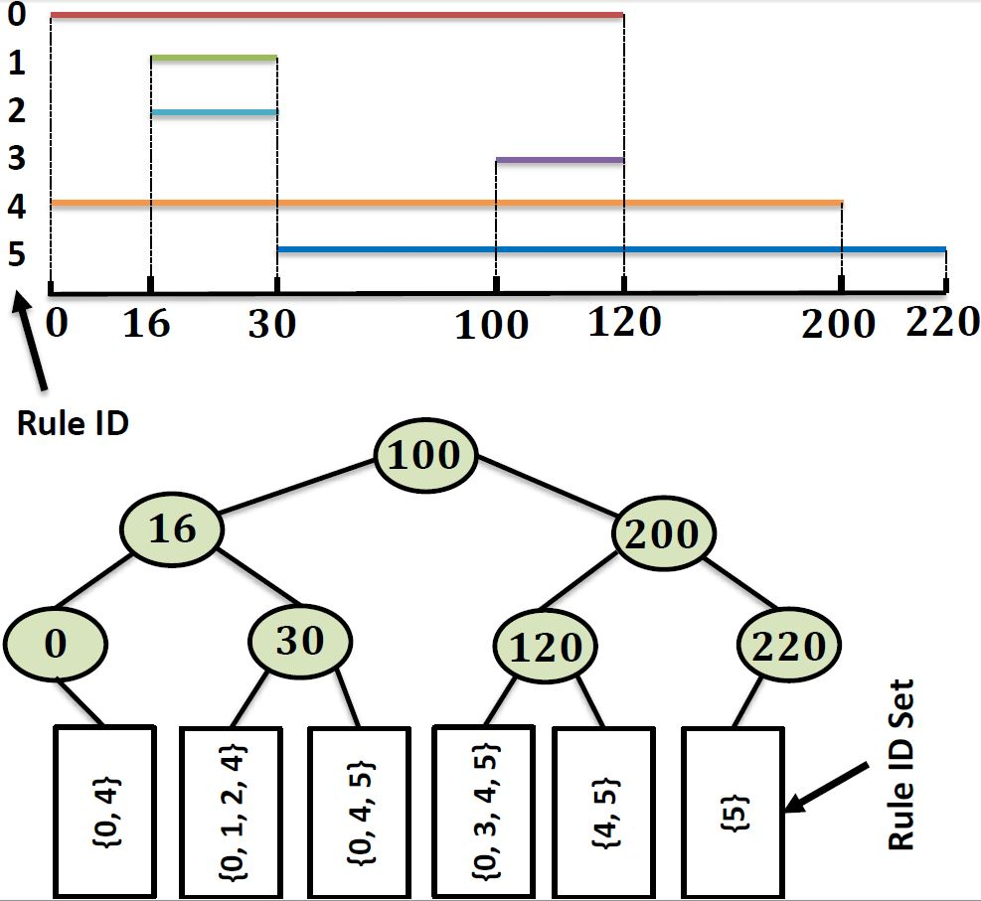
Proposed Scheme(3/7)
- Range Tree and Rule ID Set
Notes:
這部分跟training的dynamic Segment Tree相同

Slide 7
Proposed Scheme
Notes:
此部分由2個部分所構成，分別是bitonic merge及neighborhood checker所組成

Slide 8
Proposed Scheme(4/7)
- Bitonic Merge
To pipeline the merging phase and improve the overall throughput, we use
  Use a bitonic merging to merge any 2 RIDSs.
  Merge all the M RIDSs iteratively in pairs.
A bitonic merge network as BM(k), where k denotes the size of this network.
BM(k) has log(k) stages and dist(i) is the distance of two IDs, if i=0 : dist(i) = k/2
else : dist(i) = dist(i) /2
Notes:
首先，先介紹bitonic merge
這邊為了可以提高throughput，所以使用了bitonic merge

Slide 9
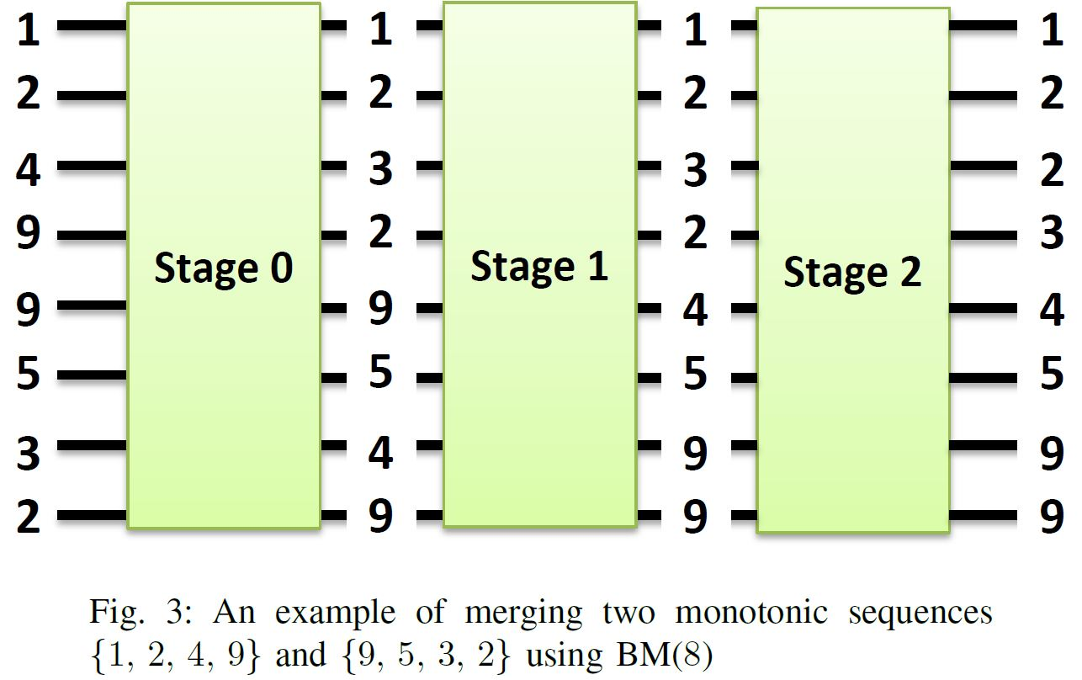
Proposed Scheme(5/7)
- Bitonic Merge
dist(i) = 4
, k = 8
Notes:
前面有提到，存在range tree中RIDS是ascending order，而使用bitonic merge必須有一個sequence是descending order，因此在merge之前會先將一個sequence reverse成descending order的形式
這邊以{1,2,4,9}、{9,5,3,2}做例子

Slide 10
Proposed Scheme(5/7)
- Bitonic Merge
dist(i) = 4
, k = 8
Notes:
前面有提到，存在range tree中RIDS是ascending order，而使用bitonic merge必須有一個sequence是descending order，因此在merge之前會先將一個sequence reverse成descending order的形式
這邊以{1,2,4,9}、{9,5,3,2}做例子

Slide 11
Proposed Scheme(5/7)
- Bitonic Merge
dist(i) = 4
dist(i) = 2
, k = 8

Slide 12
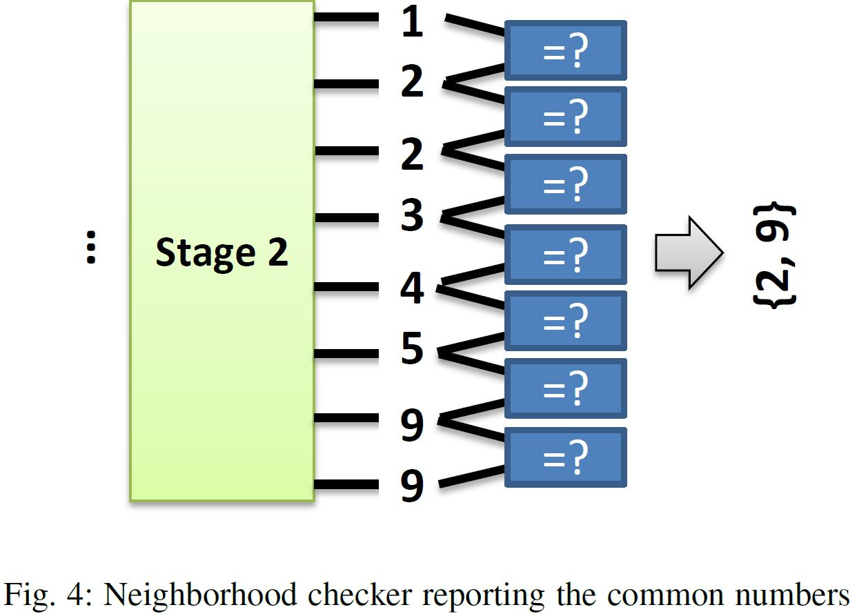
Proposed Scheme(6/7)
- Neighborhood Checker
The Neighborhood Checker (NC) will check whether the 2 input numbers are equal or not. The NC finally reports the common numbers.

Slide 13
Proposed Scheme(7/7)
- Bitonic Tree
A bitonic merging network along with an NC is only capable of collecting common numbers
For a total number of M(M filds) RIDSs, we exploit a tree-like merging network, and denote as bitonic-tree.
Each node in a bitonic-tree consists of a BM(k) and an NC; we denote the node as BMNC(k).
Notes:
透過BM、NC主要是把不同dimension的common number收集起來
力用BM、NC的特性，提出了依個tree-like的架構，叫作bitonic tree

Slide 14
Overall Architecture
Notes:
PE是紀錄tree height i的所有sub-range，而最後一個PE(以range tree中在leaf的那個PE)則是紀錄RIDS的rule ID
一個BMNC是由多個stage的BM及一個NC所組成

Slide 15
EXPERIMENTAL RESULTS(1/7)
Environment
FPGA | Xilinx Virtex 7
Logic Slice | 433,200
I/O pins | 850
BRAM | 51.6MB(on-chip)
Development Tool | Xilinx Vivado 2014.3
Notes:
實驗的環境
這邊會先分別針對不同 “rule set、elementary interval的數量、RIDS的rule ID數量及不同dimension”對throughput及resource的影響，

Slide 16
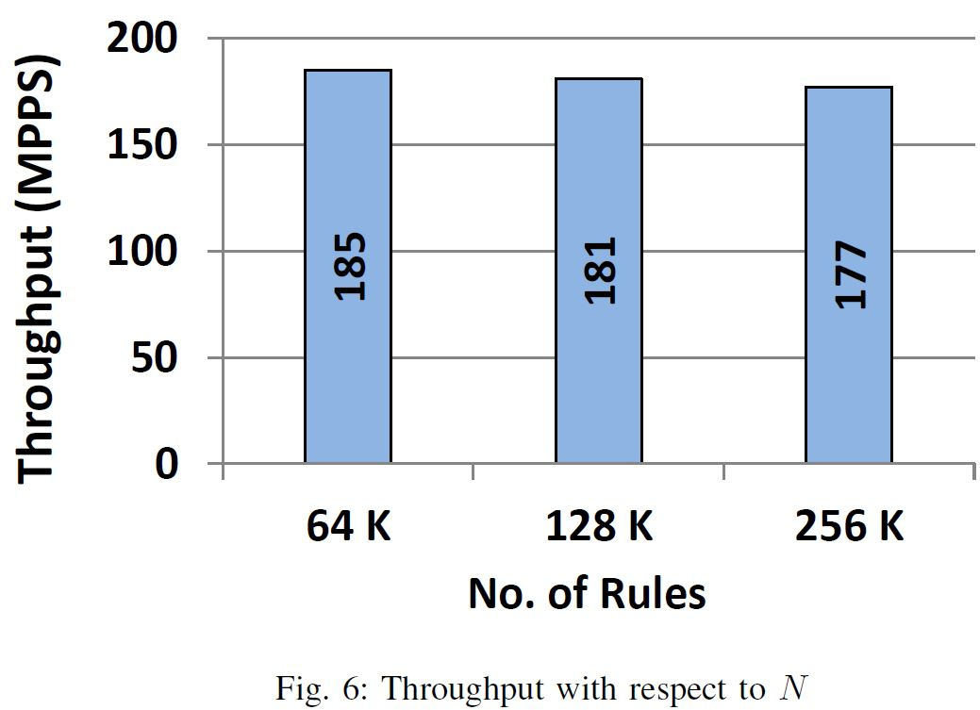
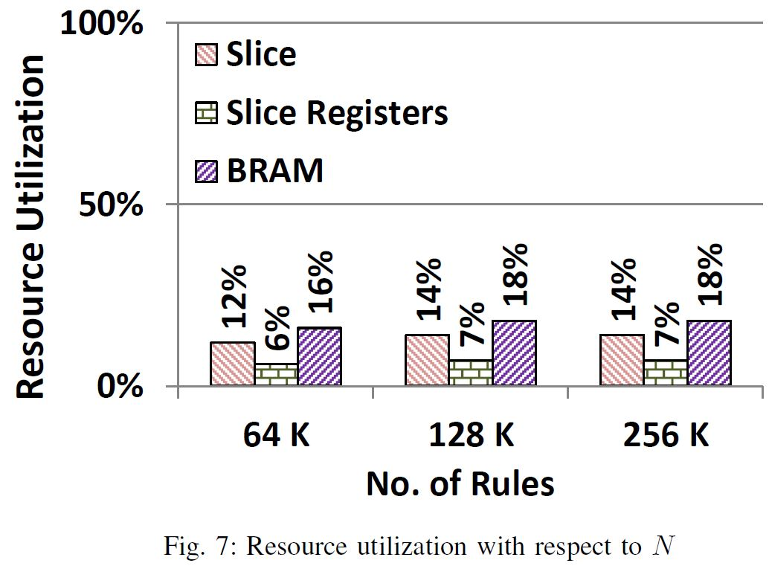
EXPERIMENTAL RESULTS(2/7)
Notes:
不同大小的rule set的throughput及resource utlization
Dim = 4, Um = 8K , Sm = 64

Slide 17
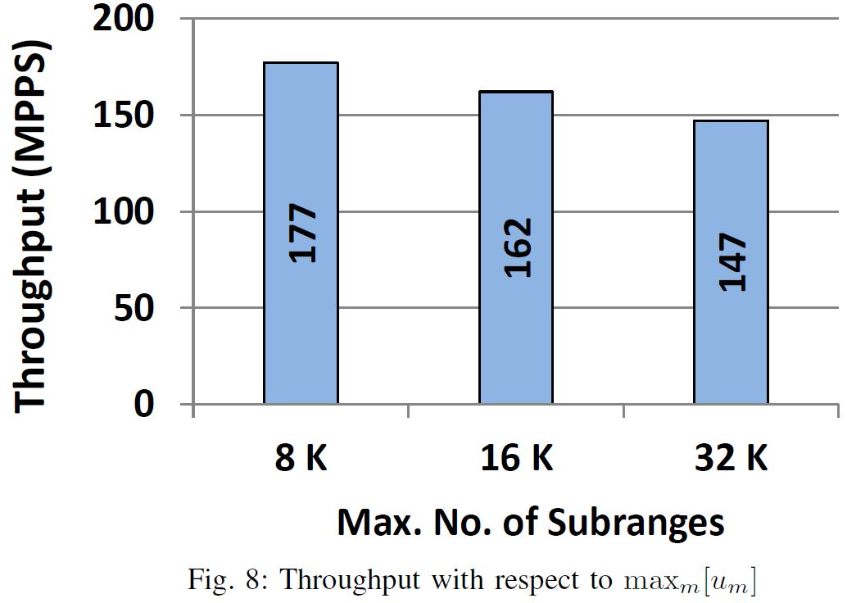
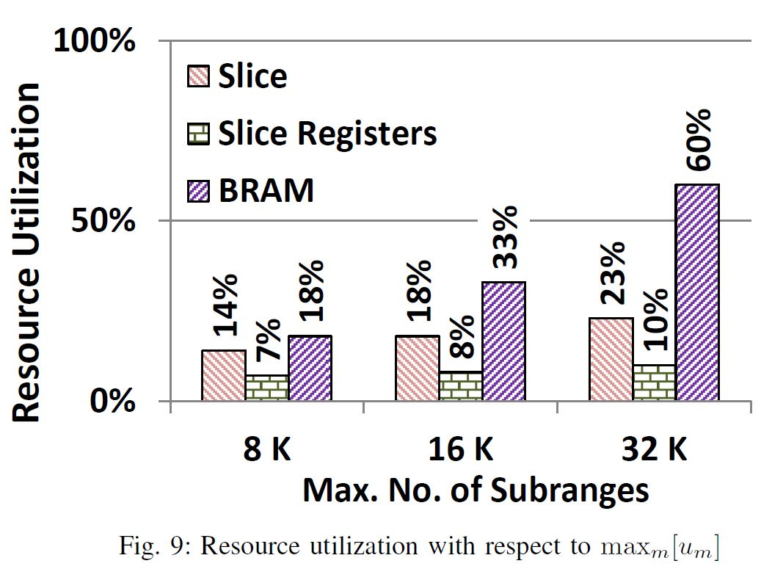
EXPERIMENTAL RESULTS(3/7)
Notes:
Um是elementary interval的數量
這邊是各種elementary interval的throughput及resource utilization
N = 256k, Dim = 4, Sm = 64

Slide 18
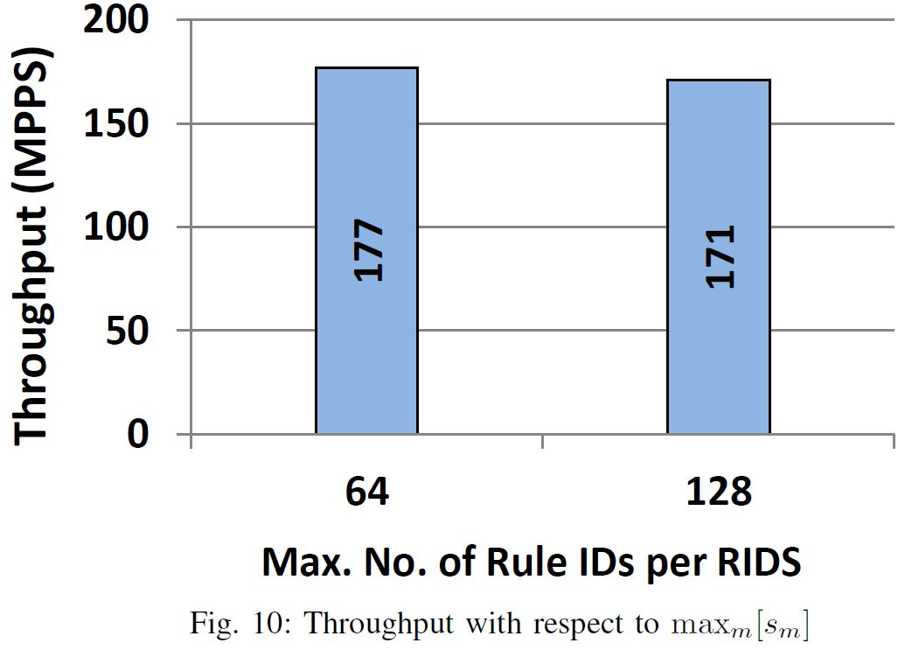
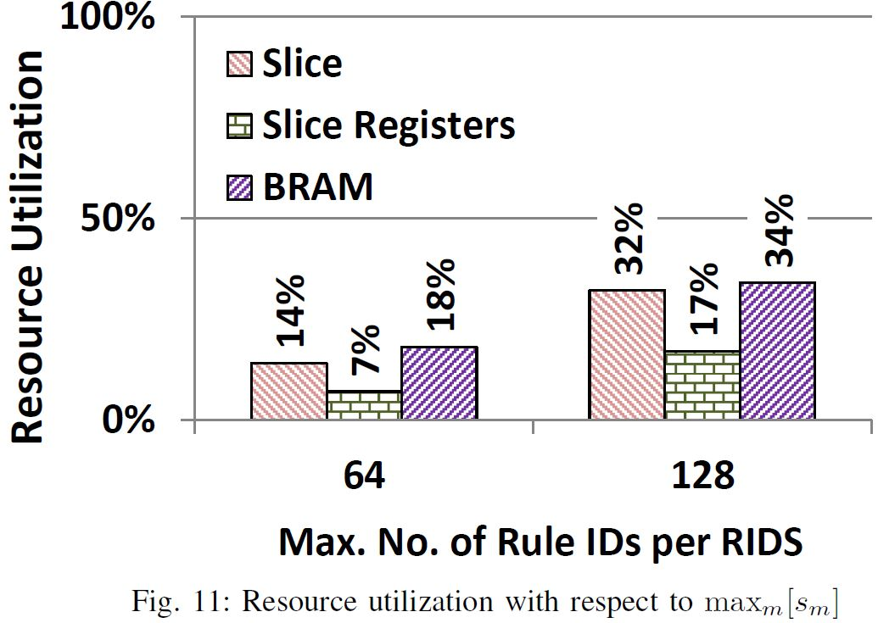
EXPERIMENTAL RESULTS(4/7)
Notes:
Sm是RIDS的rule ID數量
這是不同Sm的throughput及resource utlization
N = 256k, Dim = 4, Um =8K

Slide 19
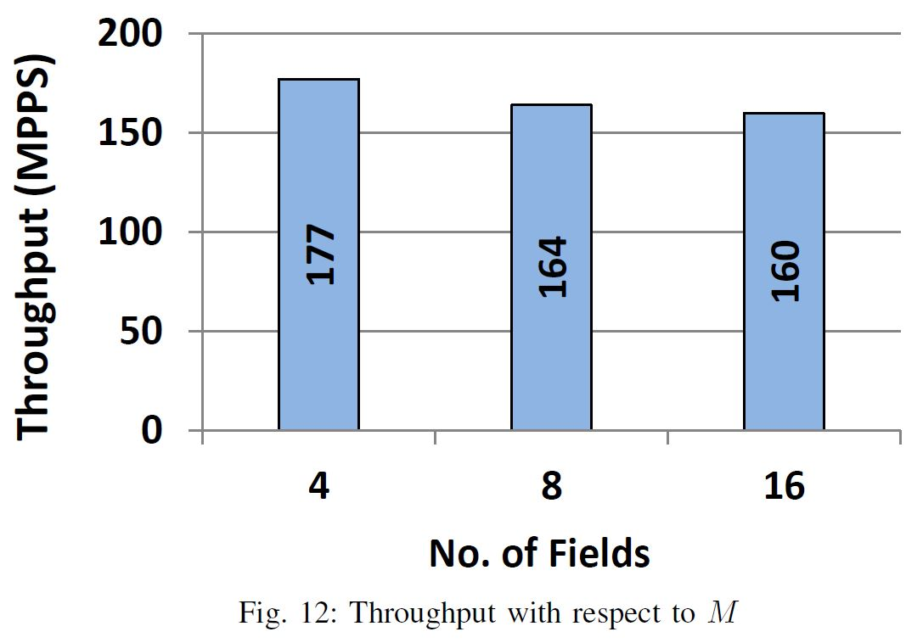
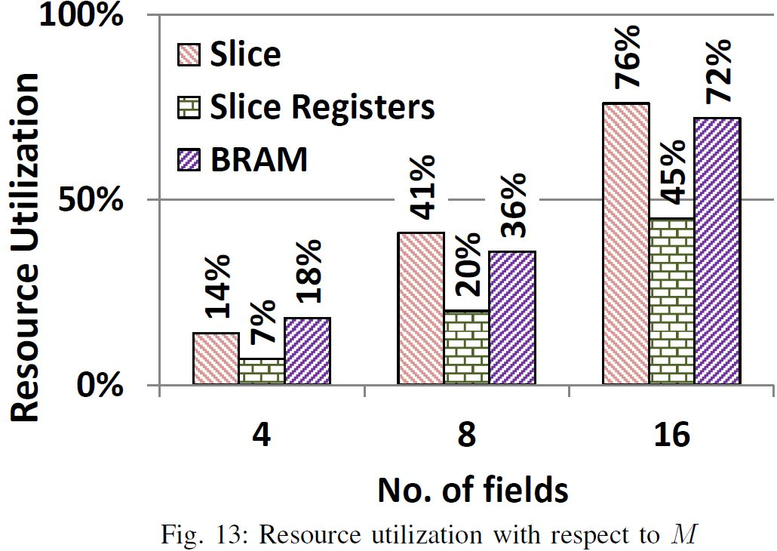
EXPERIMENTAL RESULTS(5/7)
Notes:
不同dimension對throughput及resource utlization的影響
N = 256k, Um = 8K , Sm = 64

Slide 20
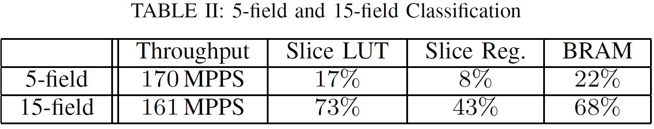
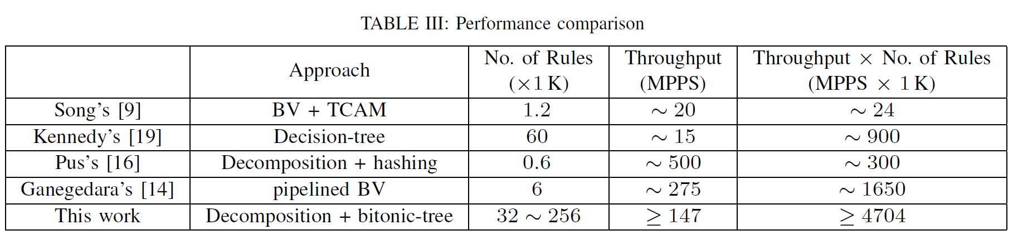
EXPERIMENTAL RESULTS(6/7)
Notes:
Table II是用 N = 256k, Um = 8K , Sm = 64
Table III 是跟其他方法的比較

Slide 21
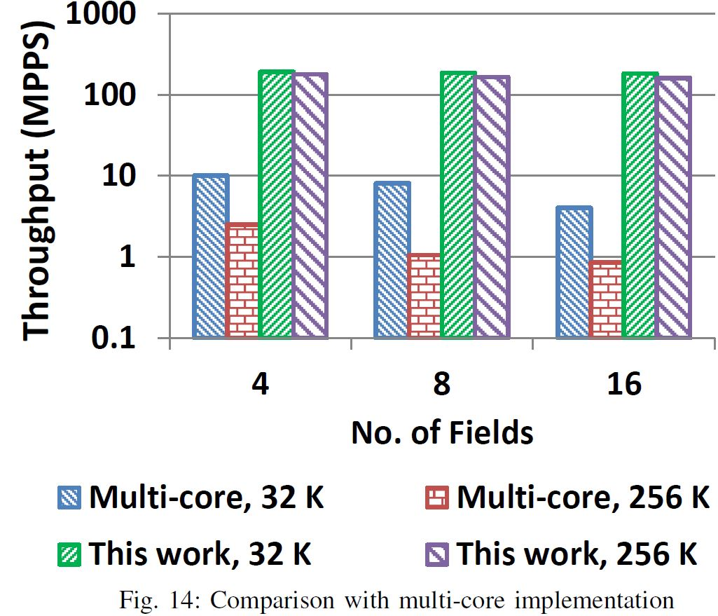
EXPERIMENTAL RESULTS(7/7)
CPU | AMD Opteron 6278
Core | 16
Frequency | 2.4GHz
L1 cache | 16KB
L2 cache | 2MB
L3 cache | 60MB
Notes:
這邊是實做在FPGA的方法跟他們另一篇實做在multi-core上的比較

